Slide 1
Date: 24th Jan,2021
Analysing & Visualizing rent houses data in Mumbai
Vishal Sudhir Sawant
1.1 Introduction
Mumbai is densely populated city on India’s west coast. A financial center. It’s India's largest city with over 603.4km area and a population of 1.84 crores. It serves as an economic hub of India, contributing 10% of factory employment, 25% of industrial output.
As I mentioned earlier that Mumbai serves as an economical hub of India, lots of peoples
move to Mumbai for doing a job, finding a job, education, labour work, etc. as we know Mumbai is a densely populated city so, it's hard to find the house on rent(in the budget of person) in this type of city.
So, to solve this problem I will be going to analyse all the rents house data of Mumbai and
find some reliable house for users.
1.2 Description of the data
After searching a couple of data provider sites, I have found perfect data set on kaggle.com, I’m going to use “Flats for Rent in Mumbai” data set from Kaggle. This data set contains data from 12/08/2019 to 14/01/2020 total of 34349 rows.
Followings are a list of columns with a small description of each:

Slide 2
area | Floor area of the property
bathroom_num | Number of bathrooms available
bedroom_num | Number of bedrooms available
city | City in which property is located
desc | Text description of the property
dev_name | Name of property developer
floor_count | Total number of floors in building
floor_num | Floor on which property is located
furnishing | Furnishing status
id | Unique ID
latitude | Latitude of location
id_string | Unique ID string used to scrape a particular HTML pageelement.
locality | Locality in which property is located
longitude | Longitude of location.
post_date | Date on which property was listed on website.
poster_name | Name of poster
price | Price of the property
project | Name of the residential complex
title | Title of the property ad on thewebsite
trans | Type of property transaction

Slide 3
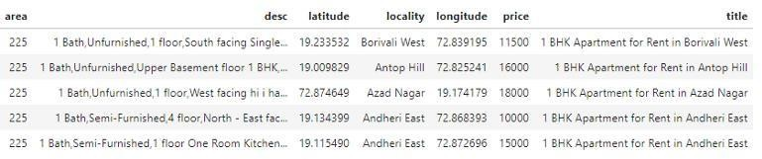
type | Type of residential complex
URL | URL of the individual property
user_type | Type of user who posted the ad
This data set contains 23 columns but, we will filter the data set and remove the un-relevant
column and keep only those column which will useful to us. we will also be going to apply data cleaning on the filtered dataset.

Slide 4
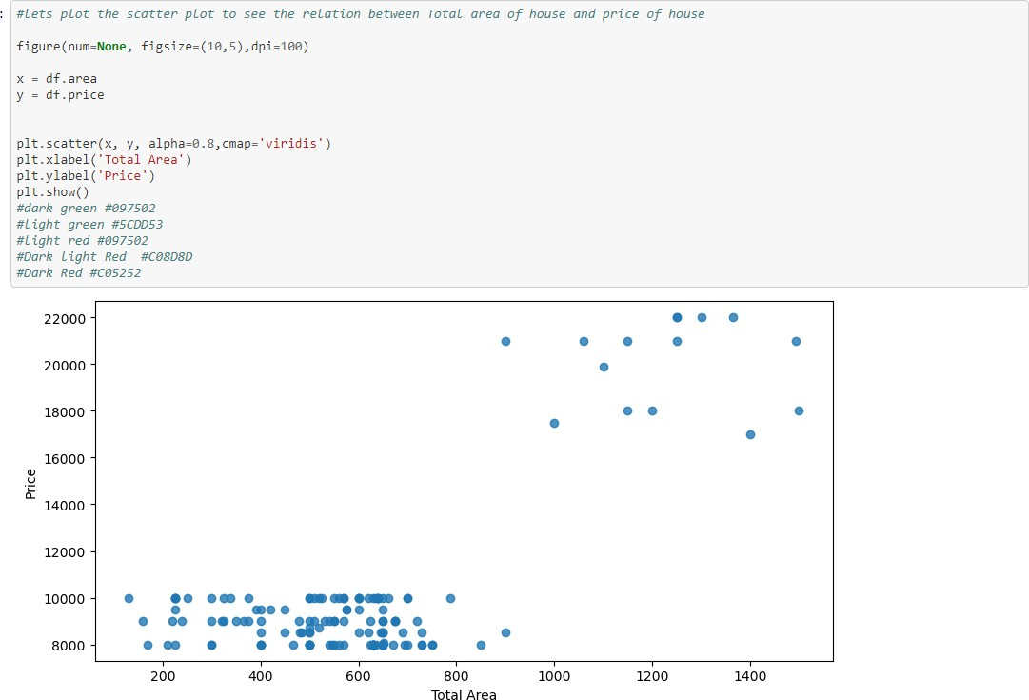
1.3 Methodology
I used a folium library to visualize all the rent house data of Mumbai. This shows relationship between total area of house and price of house.

Slide 5
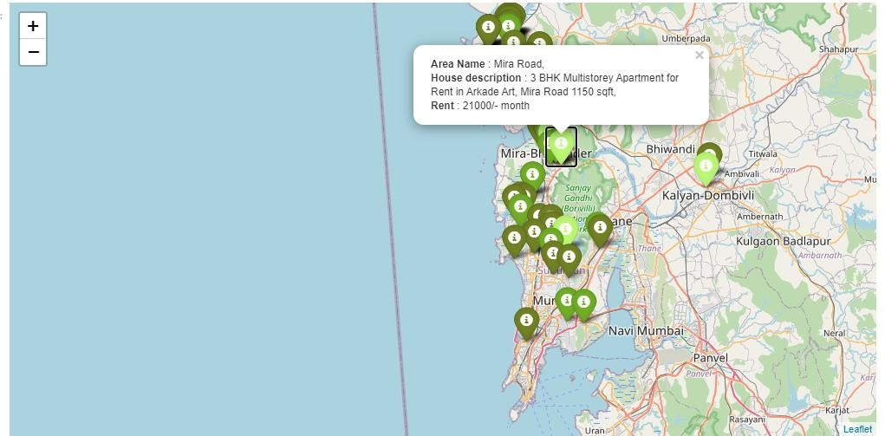
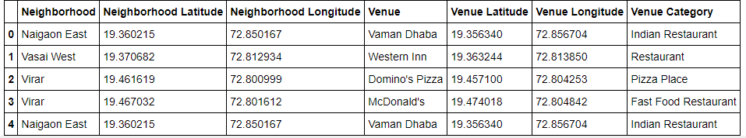
And when you click on any marker you will able to see all primary information about that rent
house.
The purpose behind the classification is to easily identify the house with low rent price to the
highest rent price. I used foursquare APIs to explore the restaurants near all rent house locations and clusters them accordingly. Foursquare return all Venus near each house and
then put all venues inside the data frame.
I have also analysed the number of venues found by foursquare API for each area (locality)

Slide 6
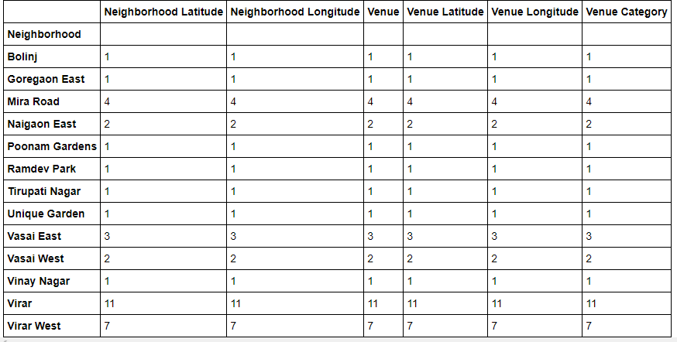
I have also analysed the number of venues found by foursquare API for each area (locality)

Slide 7
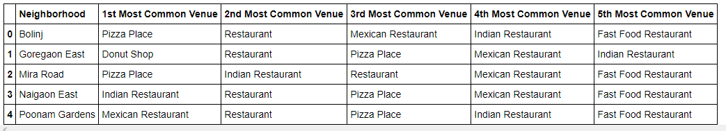
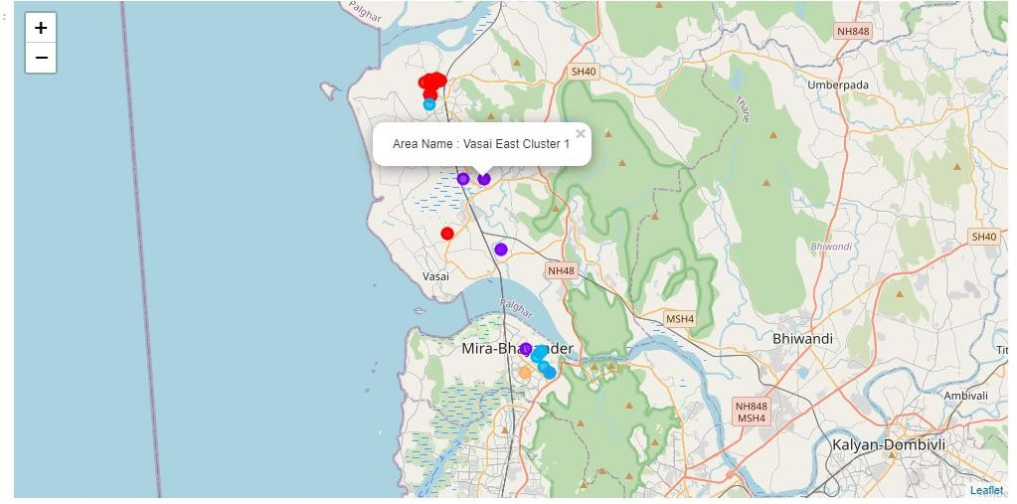
1.4 Result
As a result, I group Neighborhood(‘locality’) by the number of top 5 common venues. Then merged it with the dataframe.
After merging the venue data to the main data frame you can see the clusters map of restaurants near rent hour’s locations Mumbai.

Slide 8
1.5 Discussion
know Mumbai is a densely populated city so, it’s hard to find the house on rent(in the budget of person) in this type of city. So, to solve this problem I did the analysis of all the rent houses of Mumbai and find some reliable house by classifying them and also did exploring each nearby venue location.
1.6 Conclusion
By classifying, visualizing, and explore each nearby venue location, it is easier to make decisions for stakeholders like real-estate builders and brokers.

